Slide 1
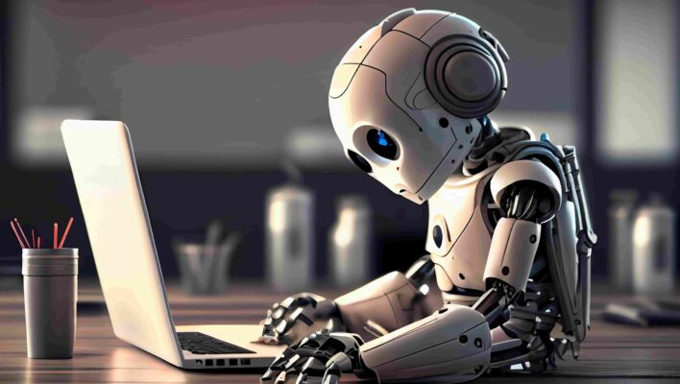
THE IMPACT OF ARTIFICIAL INTELLIGENCE ON JOB MARKET

Slide 2
Test of contents:
Introduction
Definition and scope of artificial intelligence
Overview of AI technologies and their applications
AI and job displacement
Automation of routine tasks and its impact on job roles
Industries most affected by AI-driven automation
Case studies of job displacement due to AI
New Job Opportunities Created by AI
Emergence of new job roles and professions
Skills in demand in the AI-driven job market
Examples of industries benefiting from AI-based job creation
Changing Skill Requirements
Evolving skill sets and the need for upskilling and reskilling
Demand for cognitive and non-routine skills
The role of lifelong learning in adapting to AI-driven changes
Implications for Workers and Organizations
Potential impact on income inequality and socioeconomic disparities
Strategies for job retention and career transitions
Building a culture of lifelong learning and adaptability in organizations

